Slide 1
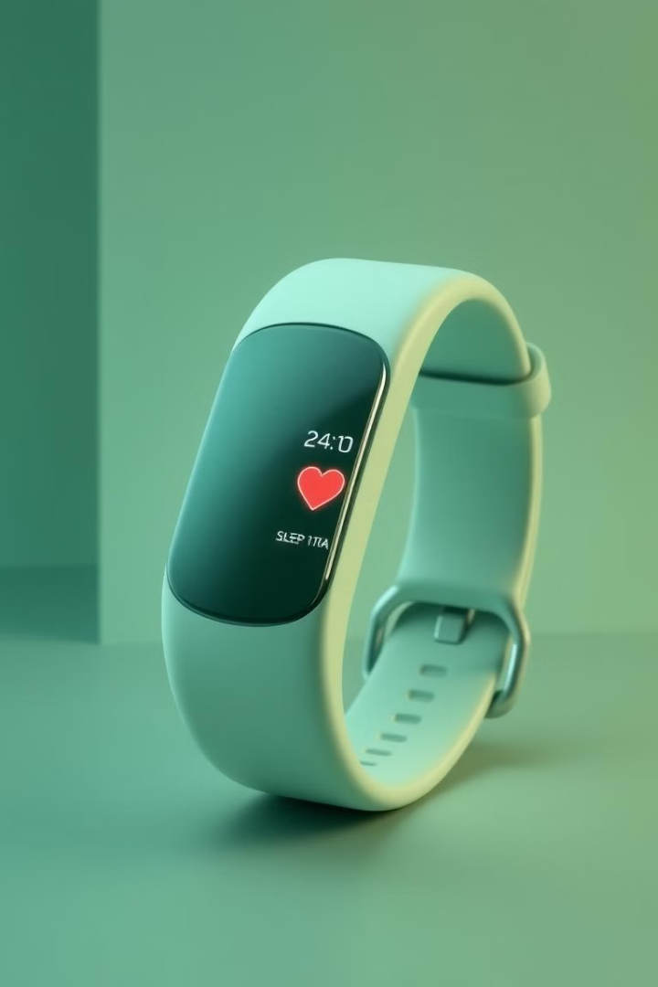
Health Tracker with Predictive Analysis
Welcome! Today we will explore a health tracker that uses predictive analytics to promote proactive health management.
by
Chethan D B - 4AL22CS029
Chethan Kumar - 4AL22CS030
Chethan L R - 4AL22CS031
Chinmay Gowda - 4AL22CS032
Guided by -
Dr. Chandra Nayak

Slide 2
AGENDA
Abstraction
Introduction
Existing System
Drawbacks of existing system
Advantages
Sample Screen Shots
Future Work
Conclusion

Slide 3
Project Abstract
Objective
Key Features
Developing a health tracker that leverages predictive analytics for proactive health management.
Log health metrics, provide insights and personalized recommendations, set medication reminders, and generate alerts.

Slide 4
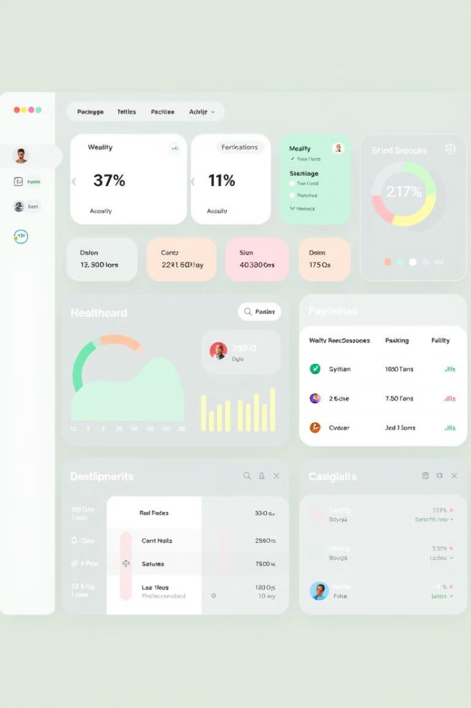
Introduction
Purpose
Benefits
To design a system that empowers users to proactively monitor and manage their health.
Collects user data, delivers actionable insights, and encourages healthy habits through timely suggestions.
Target
General users seeking enhanced health tracking and personalized guidance.

Slide 5
Existing Systems
Traditional
Challenges
Manual tracking of health metrics, limited personalization in available tools.
Reactive approach, lack of real-time predictive analysis, limited integration with wearable devices.

Slide 6

Drawbacks of Existing Systems
Lack of Alerts
Limited Integration
Missed opportunities to address potential health risks early.
Inconsistent compatibility with wearable devices for seamless data capture.
Complex Interfaces
User-unfriendly designs hinder engagement and long-term use.

Slide 7
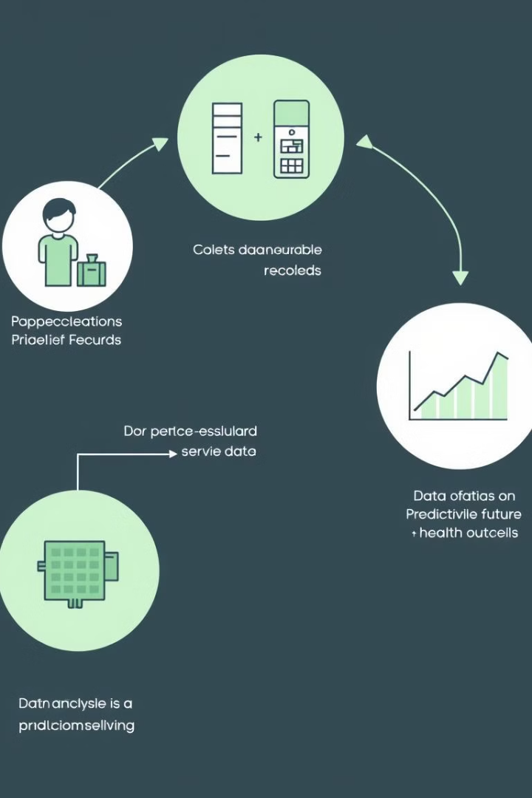




Advantages of the Proposed System
Proactive Monitoring
Personalized Insights
Predictive analytics identifies potential health risks using machine learning.
Tailored recommendations based on user data, promoting individual health goals.
User-Friendly
Data Security
Intuitive design for easy navigation, accessible across mobile and web platforms.
Ensures compliance with health data protection standards for user privacy.

Slide 8
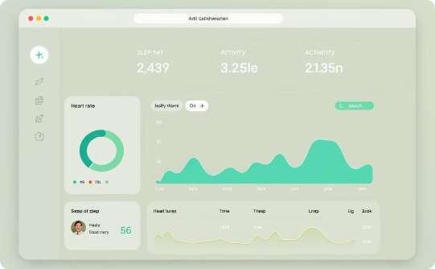
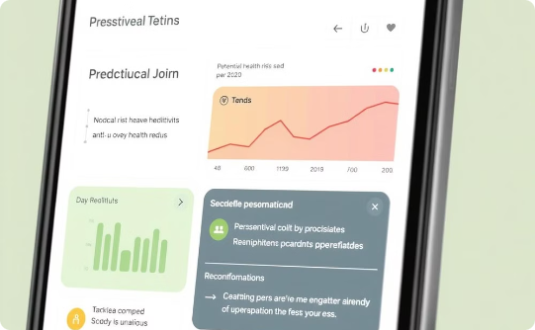
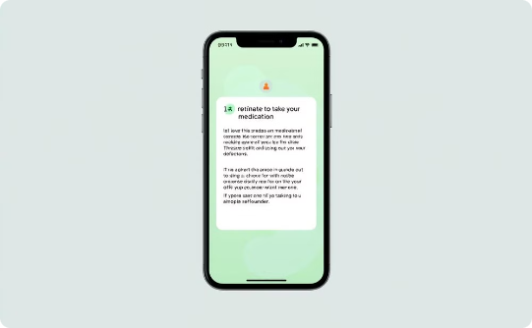
Sample Screenshots
Dashboard
Predictive Analysis
Reminders and Alerts
Provides a comprehensive overview of user health metrics.
Identifies potential health risks and suggests preventative measures.
Provides timely reminders for medications and potential health concerns.

Slide 9
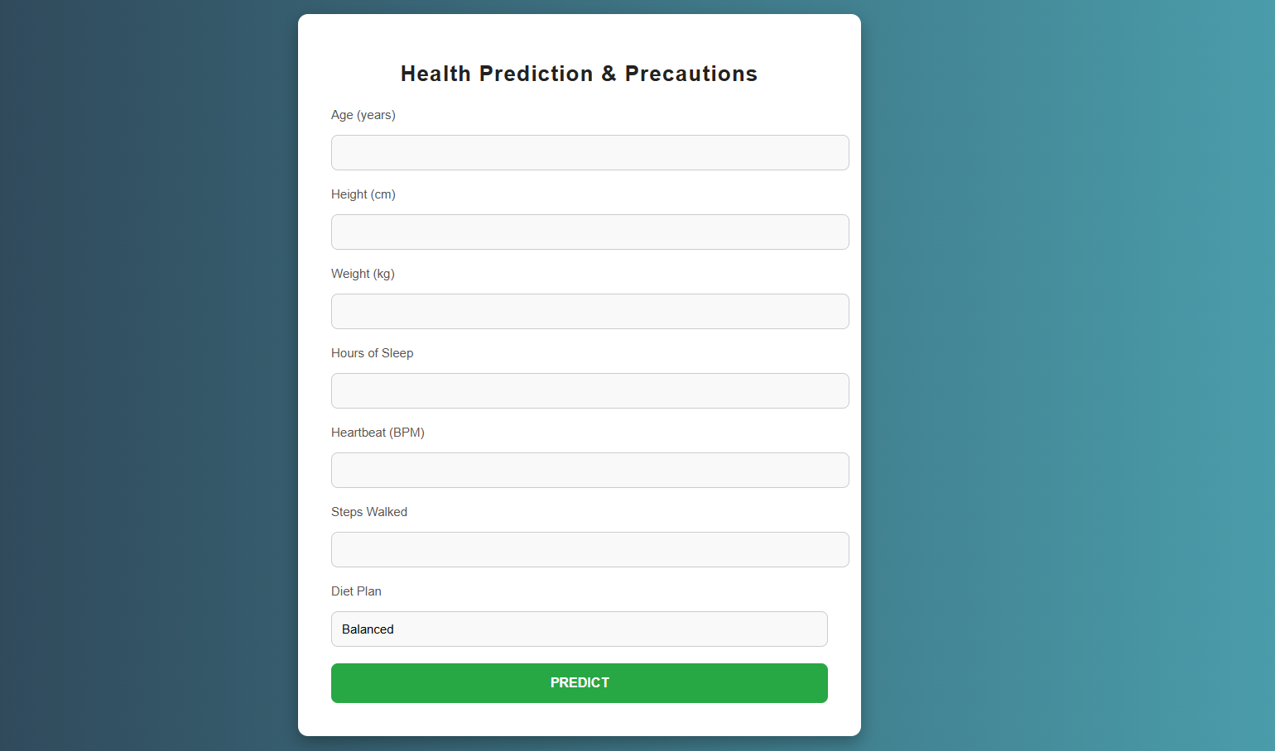

Slide 10
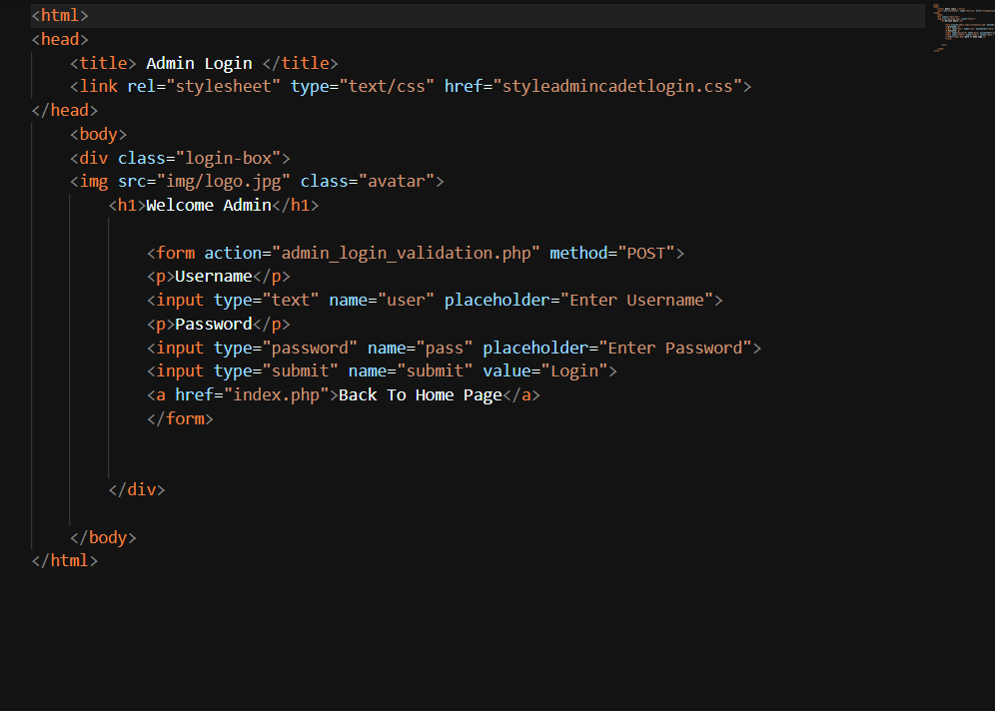
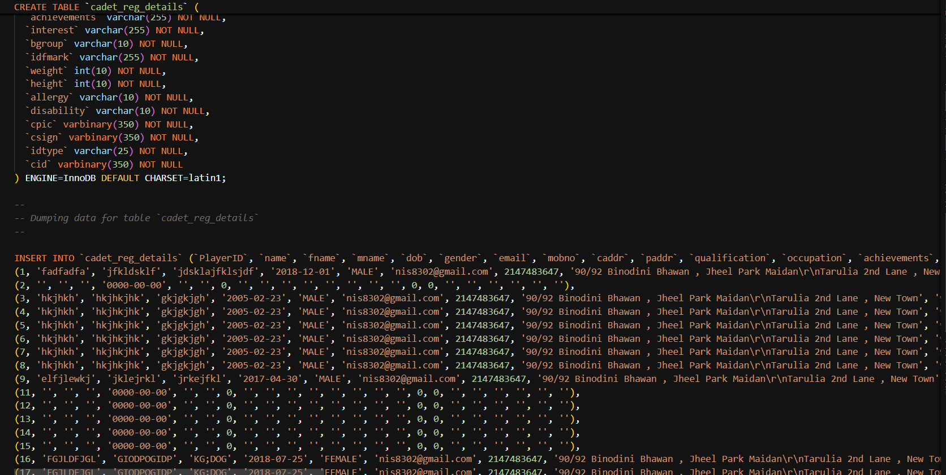

Slide 11
Future Work
Advanced Integration
1
Enhanced compatibility with wearable IoT devices for seamless data collection.
AI-powered Chatbot
2
Personalized health advice and support through interactive chatbot functionality.
Expanded Metrics
3
Inclusion of mental health metrics for holistic well-being tracking.
Multilingual Support
4
Enhanced accessibility through support for various languages.

Slide 12



Conclusion
Goal
1
To empower users to proactively manage their health through personalized insights and actionable recommendations.
Impact
2
Bridging the gap between technology and preventive healthcare, promoting healthier lifestyle choices.
Future
3
Continued innovation and development to enhance user experience and expand functionalities.

